Slide 1
Survey of Ramen Restaurants in Japan
Capstone Project – The Battle of Neighbourhood

Slide 2
Introduction
Japan is becoming the new destination for immigrants
With the rise in population, there is an ever-increasing demand for food variants
Japanese Sushi and Ramen are popular food items outside Japan
Owing to increasing immigration, stakeholders would like to know the following –
Is the time right to open more outlets?
Is the overall rating of existing restaurants good enough?
With the following exercise, let us see if we can help them with these decisions

Slide 3
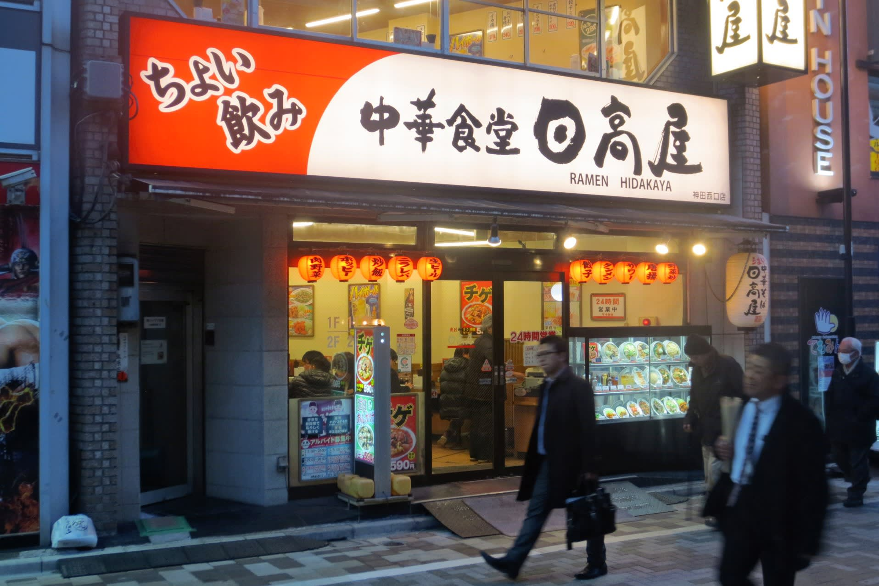
Data Sources
Target Audience
List of cities in Japan from -
https://en.wikipedia.org/wiki/List_of_cities_in_Japan
Geospatial data of the top 9 populated cities from -
https://www.latlong.net/category/cities-111-15.html

Slide 4
Approach
Picked up data from Wikipedia to get the list of cities in Japan
Picked the data for longitude and latitude for the 9 most populated cities in Japan
Using Foursquare, identified the venues in these 9 cities
Plotted the bar graph for the count of Ramen restaurants in the above 9 cities
Explored the venues and identified the topmost ratings and likes
Plot the trending venue in Tokyo

Slide 5
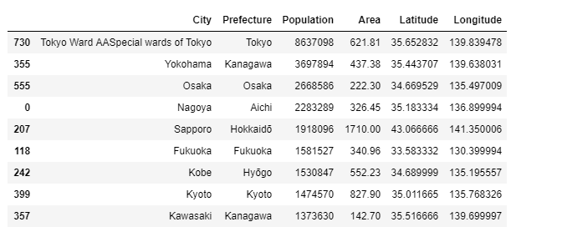
Primary Dataset

Slide 6
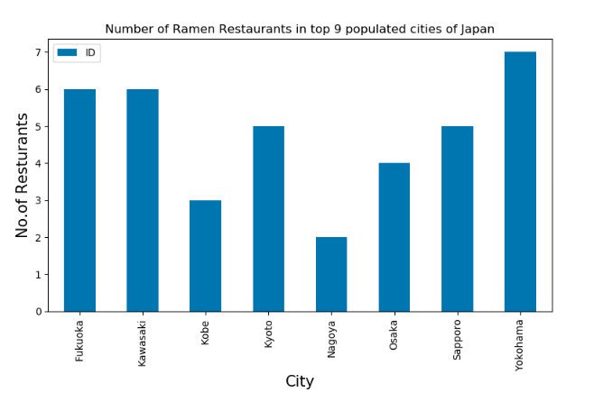
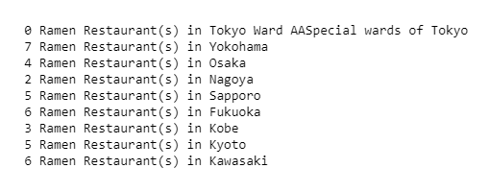
Ramen Restaurants in Top 9 cities

Slide 7
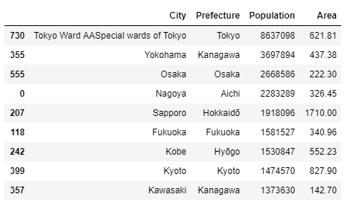
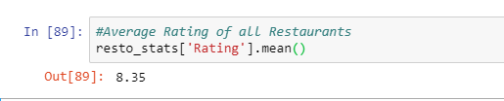
Observations
Good Average Rating
Good Scope for opening new Ramen outlets

